Slide 1
Genome-wide Analysis of Groucho Function in Drosophila Embryogenesis
Michael Chambers

Slide 2
Gene regulation through concerted action of activators and repressors
On
Co-R
On
Off
A
R
A
Co-A
On
F
F
Co-R
Off
F

Slide 3
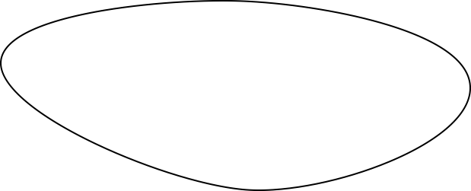
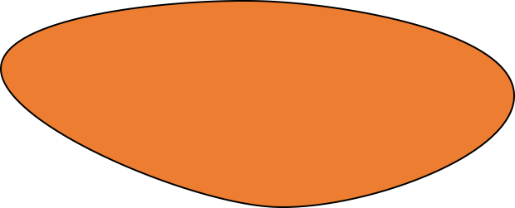
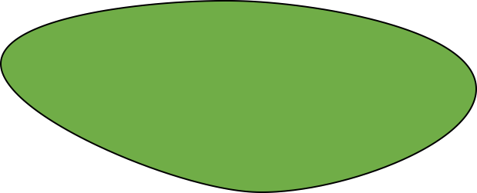
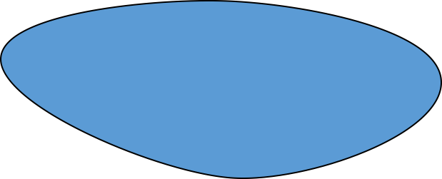
Spatial and temporal regulation of gene expression in development
On
A
Off
R

Slide 4
Morphogen gradients designate cell fate in embryogenesis
Low
Dorsal ectoderm
Embryo
Embryo
Cross-Section
Nuclear Dorsal
Neuroectoderm
High
Mesoderm

Slide 5
Groucho is a co-repressor integral to Drosophila development

Slide 6
Groucho is recruited by multiple sequence-specific factors
Dorsal-ventral patterning
Dorsal
Brinker
Ind
Vnd
Anterior-posterior patterning
Segmentation
Hairy
Runt
Even-skipped
Odd-skipped
Sloppy-paired 1
Engrailed
Knirps
Goosecoid
Terminal patterning
Capicua
Huckebein
Notch signaling
Su(H) E(spl)

Slide 7
Multiple potential mechanisms of Gro-mediated repression
Seikya and Zaret, 2007
Zhang and Emmons, 2002
Cai et al, 2003
Figures Turki-Judeh and Courey, 2012

Slide 8
Outline
A genome-wide survey of Groucho in the early embryo
Identifying components of the Groucho gene regulatory network
Groucho regulation and RNA PolII stalling

Slide 9
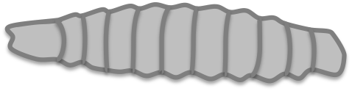

Genomic scale analysis of Groucho’s functions in early fly development
Embryo
24 hr
Larva
4 days
Pupae
5 days
Adult
RNA-seq
Nascent-seq
ChIP-seq
mRNA accumulation
pre-mRNA profiling
Groucho binding
Notes:
nascent-seq: Distribution of ternary elongation complexes
----- Meeting Notes (5/30/13 12:52) -----
Genome-wide instead of genomic scale
24 hr embryogenesis
Pupal 5 days ?
Histone marks under chip-seq

Slide 10
Groucho is recruited to thousands of sites throughout the genome
4 – 6.5 hr
6.5 – 9 hr
1.5 – 4 hr
Notes:
revise venn or use novel image

Slide 11
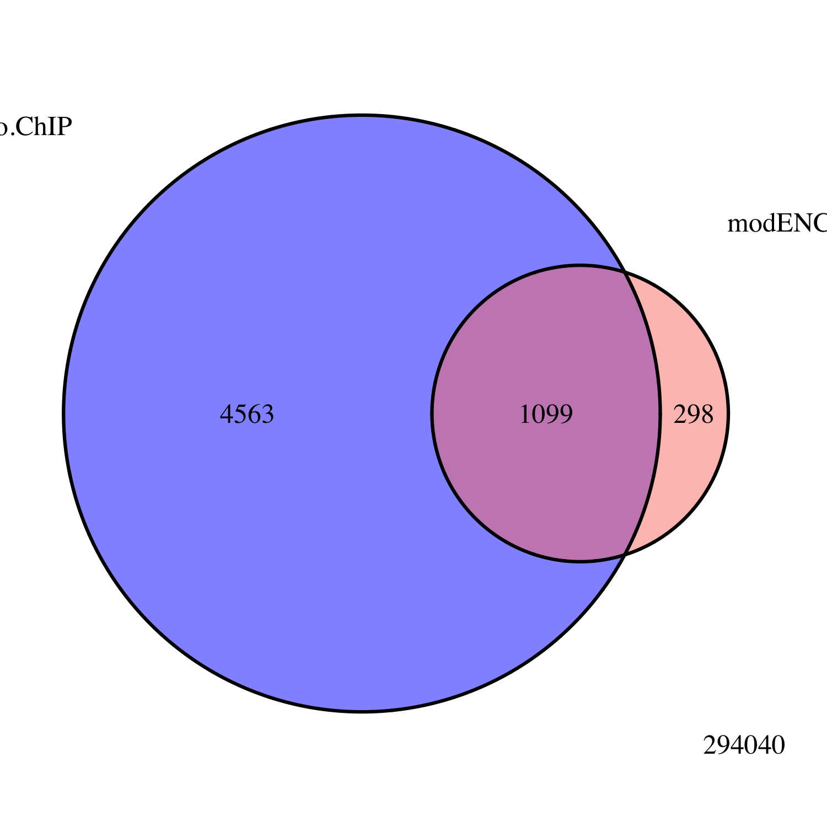
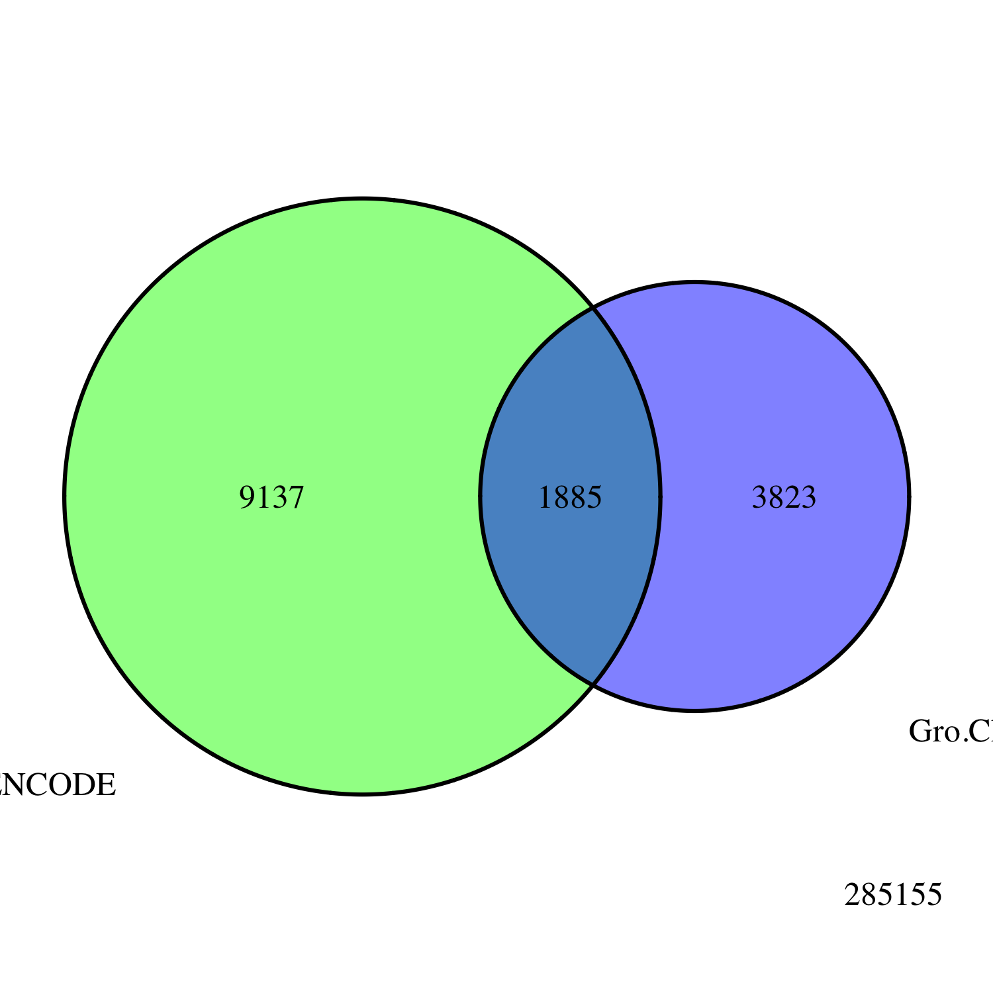
Embryo
Gro ChIP-seq
All Peaks
modENCODE
Embryo
Gro ChIP-chip
Embryo
Gro ChIP
All Peaks
modENCODE
White Pre-Pupae
Gro ChIP-chip
3823
1885
9137
Notes:
Title chip-seq validation

Slide 12
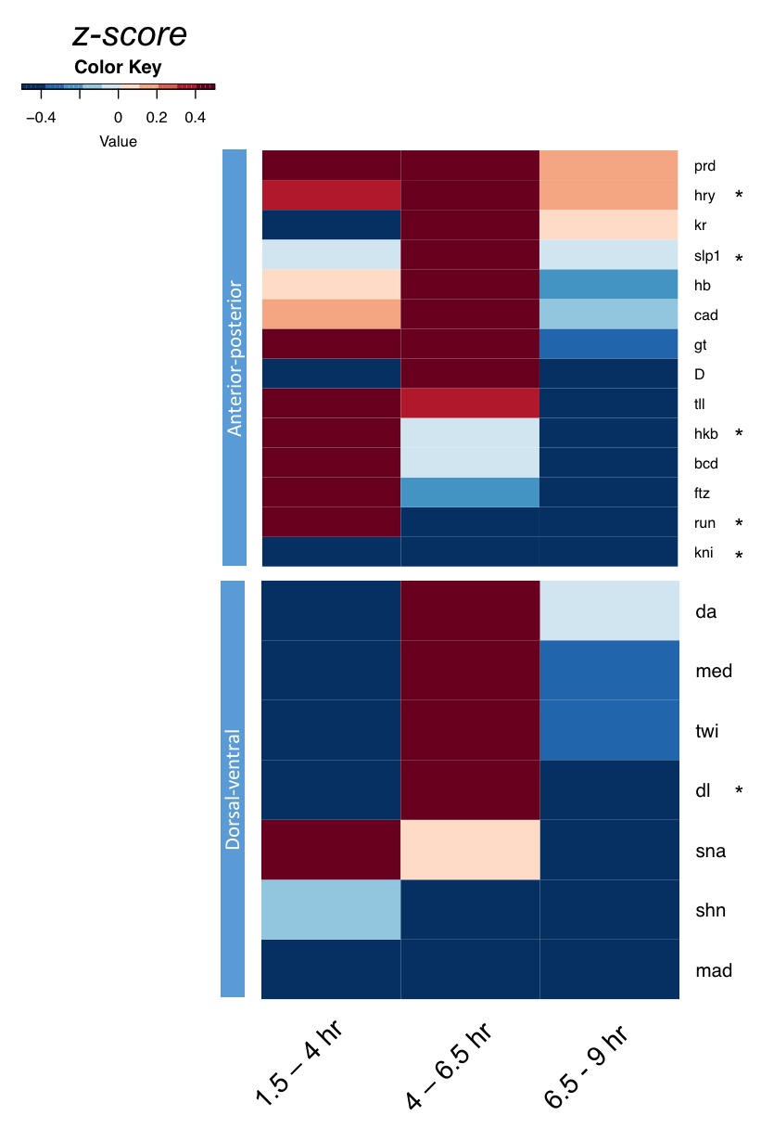
Gro colocalizes with multiple developmental factors

Slide 13
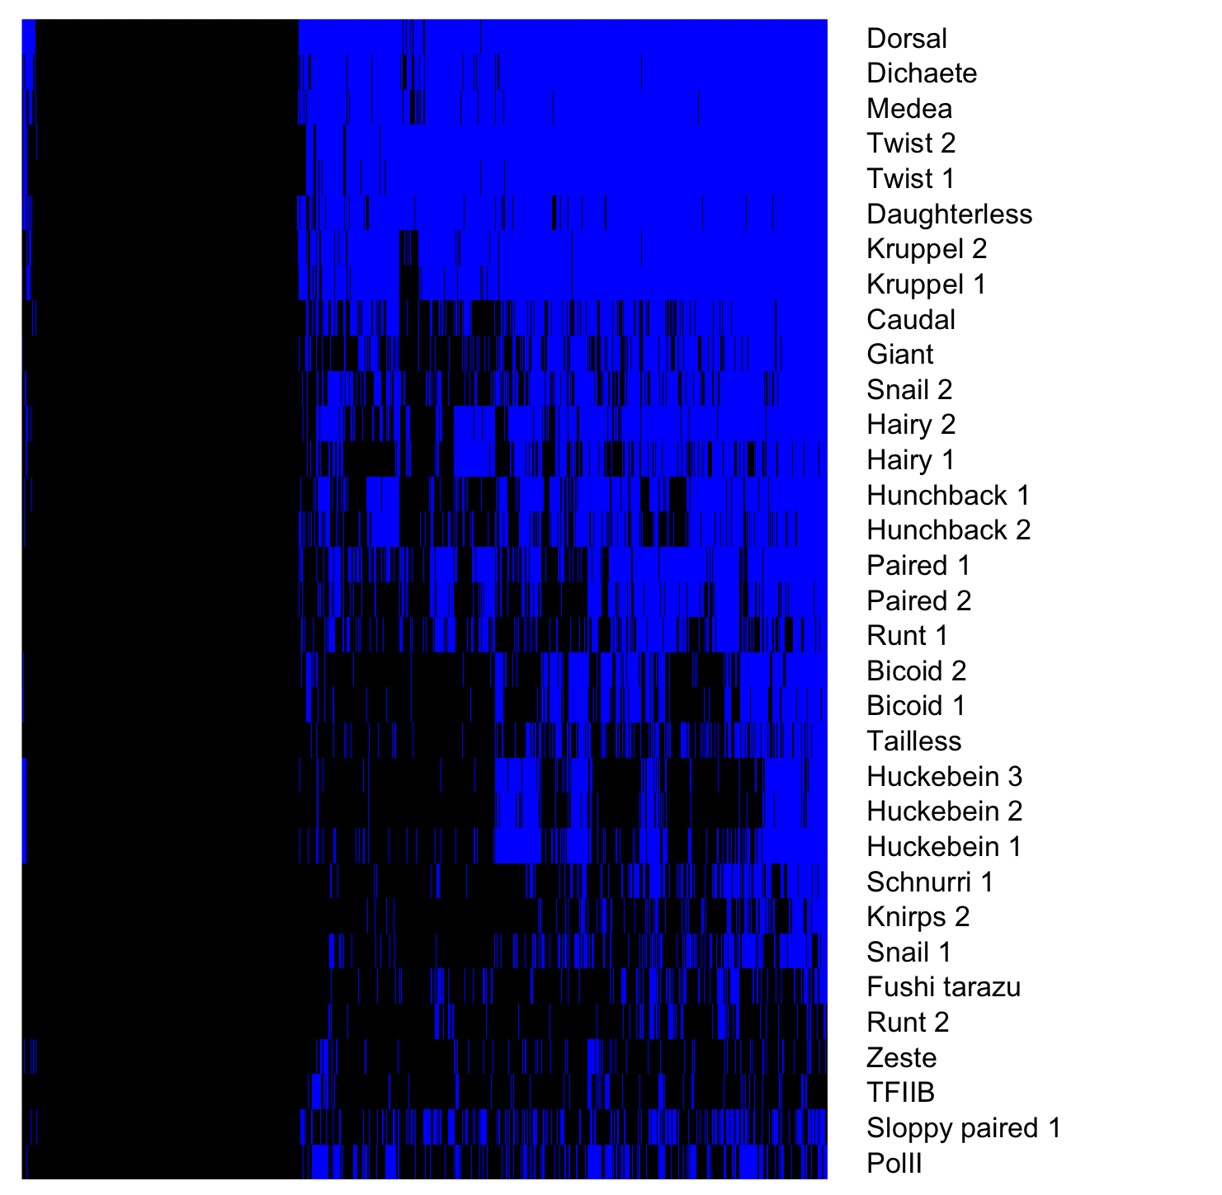
Gro binding sites overlap many additional TFs
Gro binding sites, 1.5 – 4 hr embryos
Factor occupancy

Slide 14
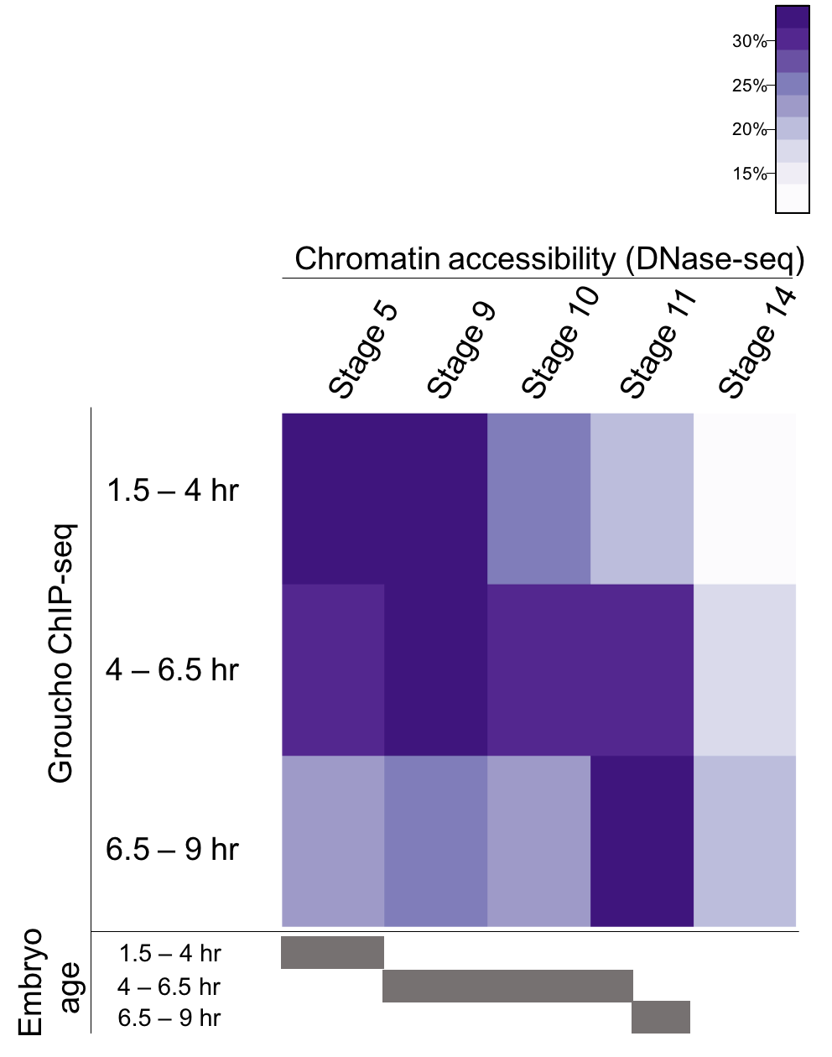
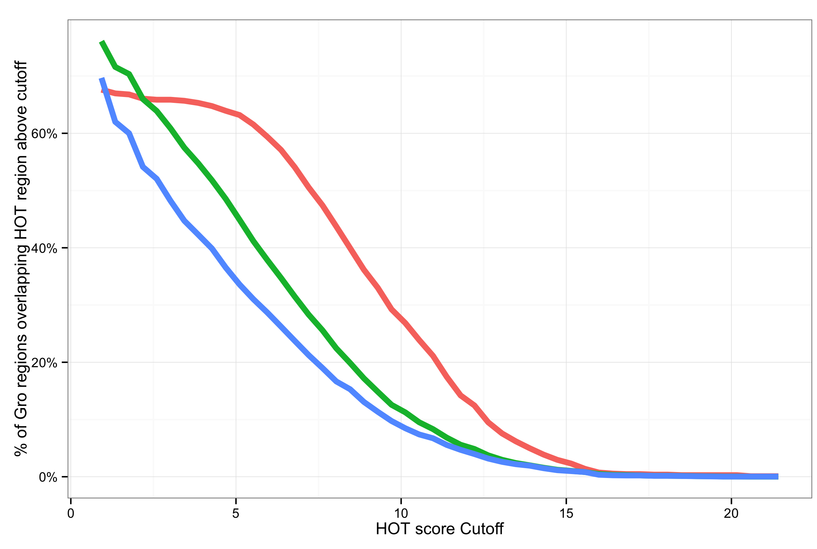
Gro is frequently recruited to areas of high TF density
Notes:
Legend
High accessibility
HOT region explanation

Slide 15
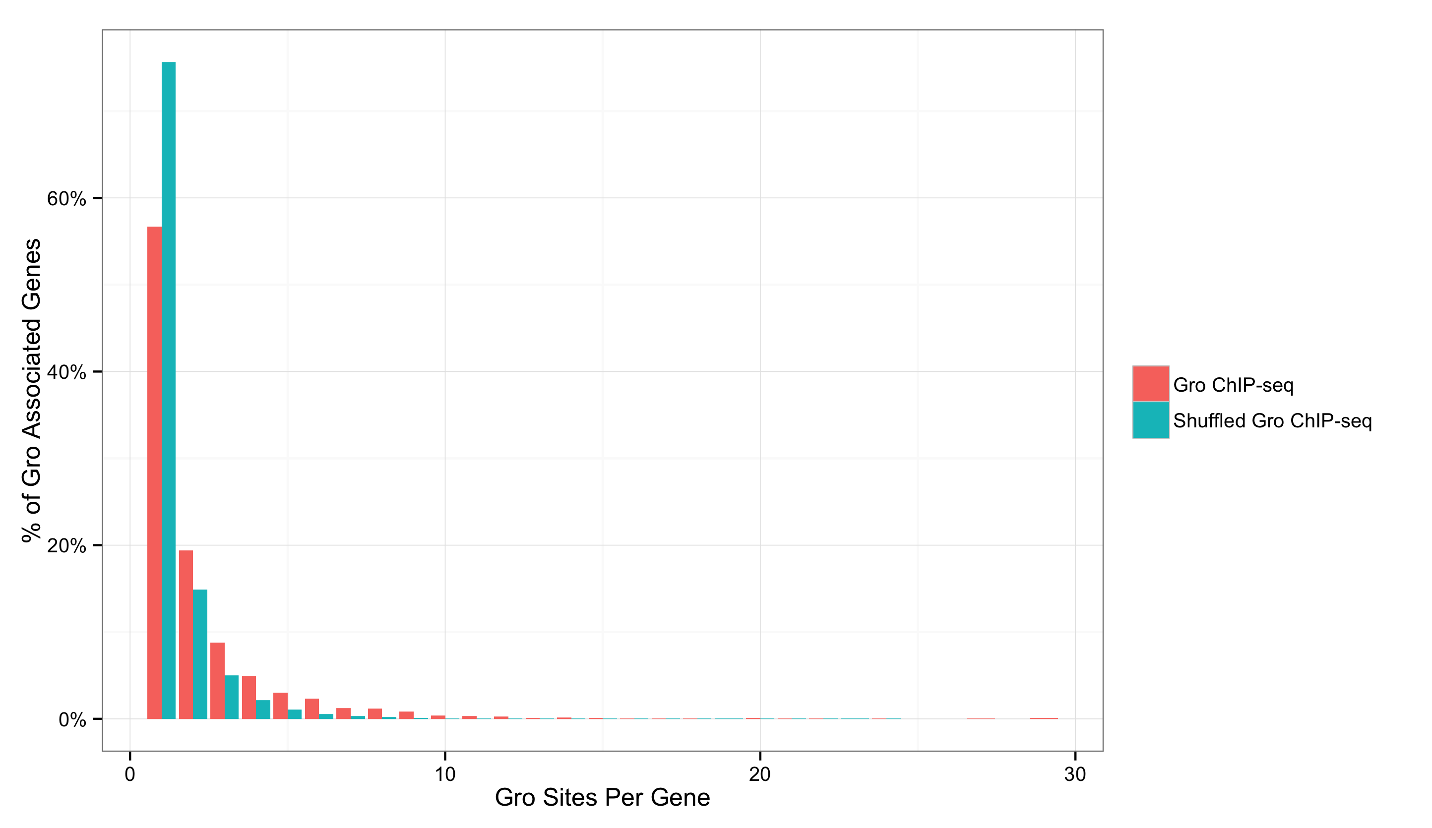
Binding to genes is enriched for multiple peak clusters
1
2
3
4
5
Notes:
Spreading vs looping

Slide 16
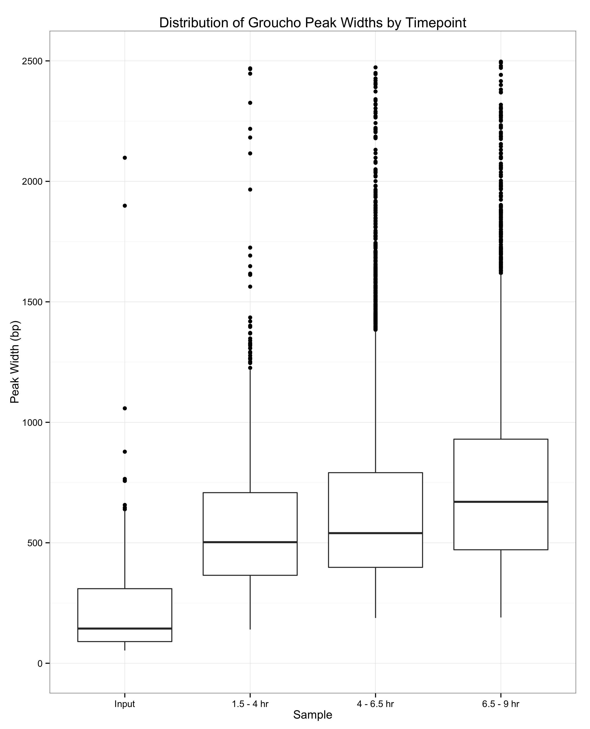
Gro binding is not indicative of spreading
2500 -
2000 -
1500 -
1000 -
500 -
0 -
1.5 – 4 hr
4 – 6.5 hr
6.5 - 9 hr
Notes:
y-axis
Zaret lab data

Slide 17
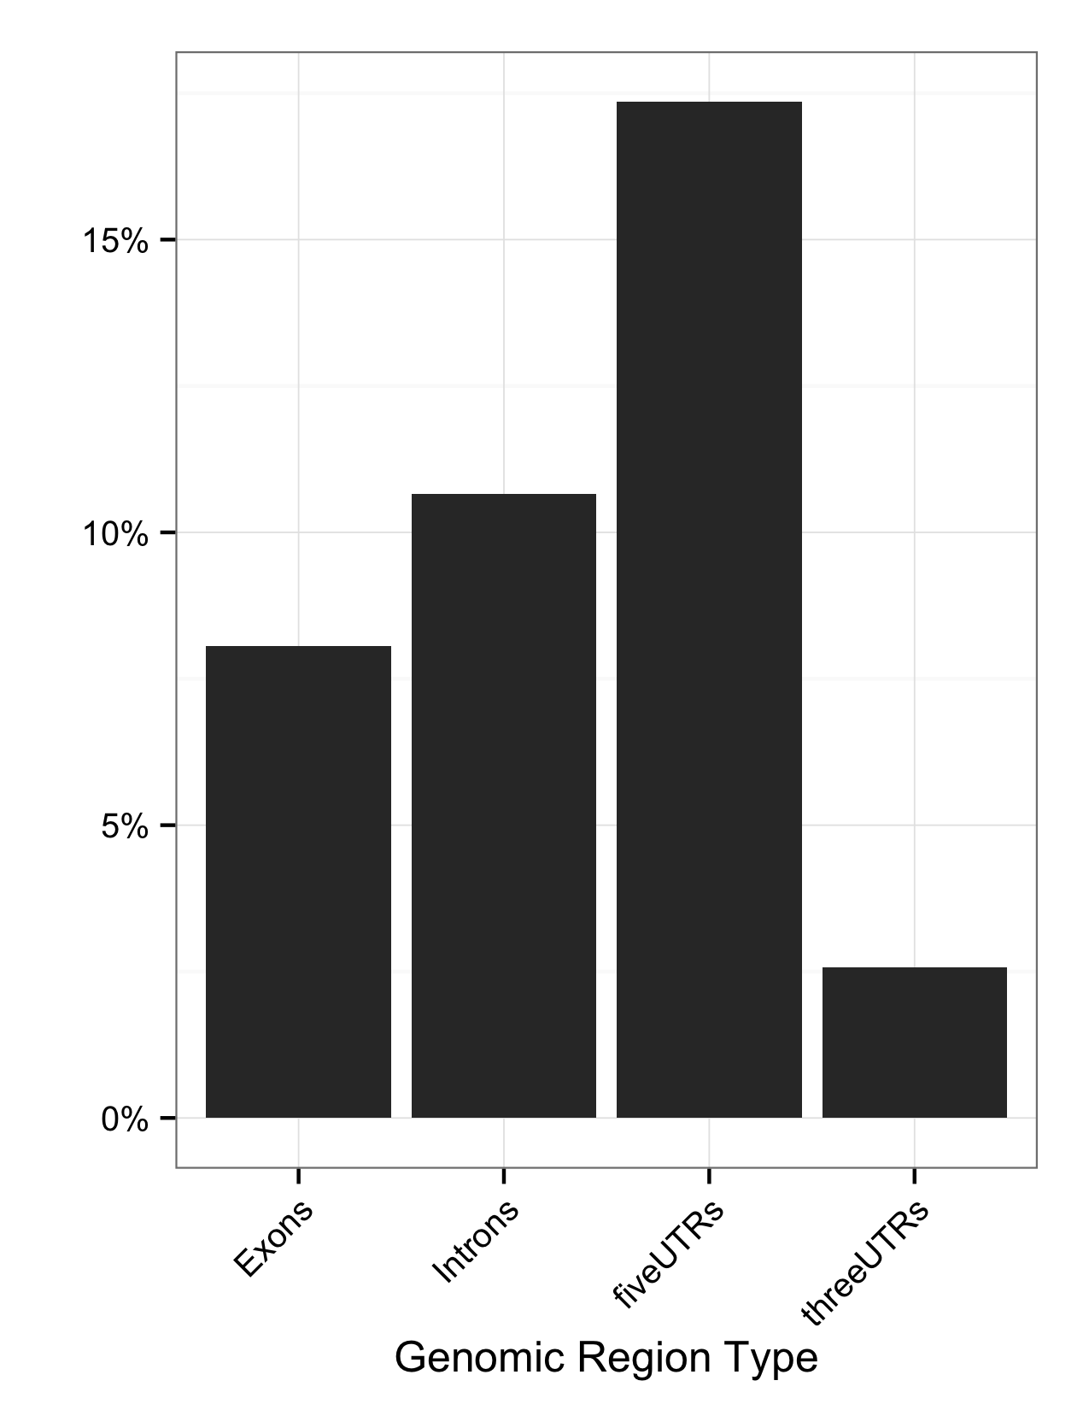
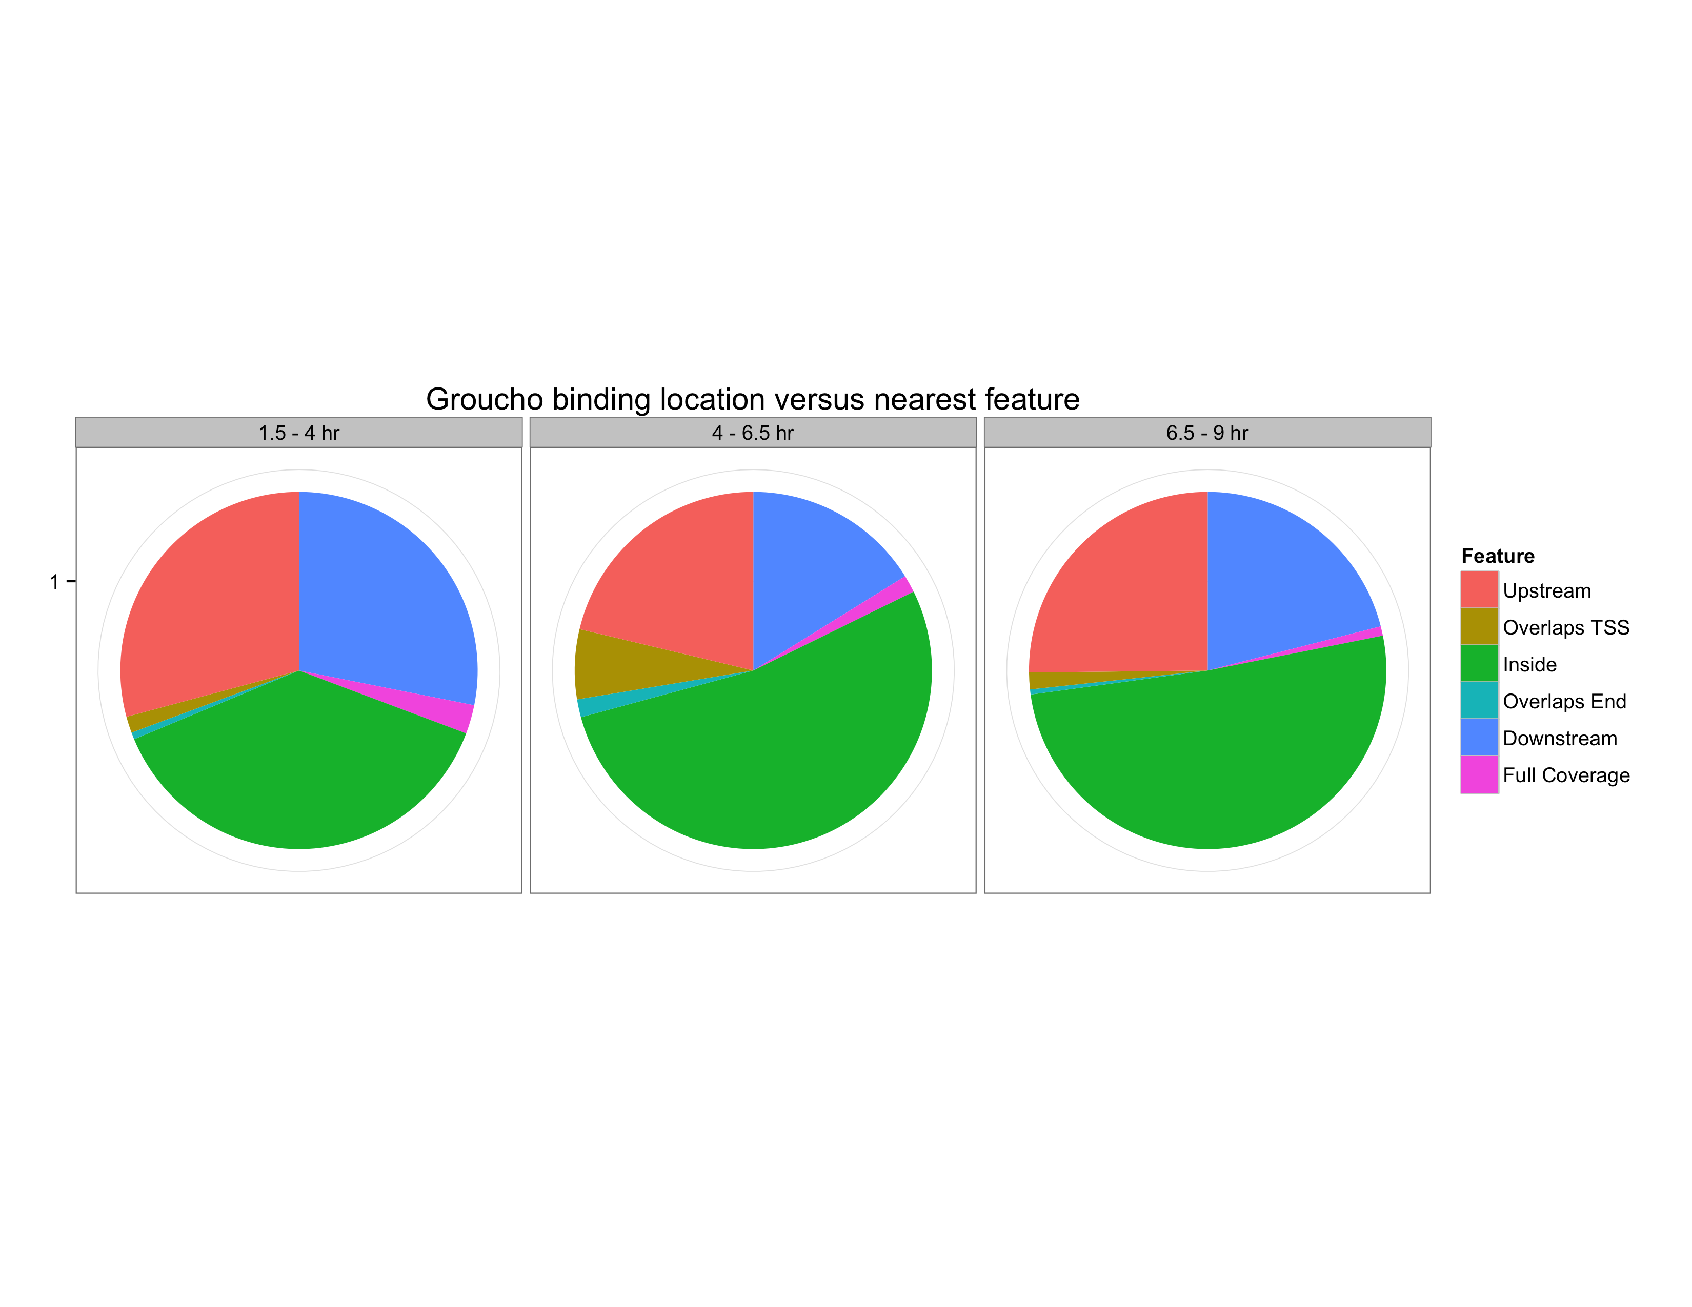
Gro binding is enriched within 5’ segments of genes
Fraction of Gro binding sites
Feature length normalized

Slide 18
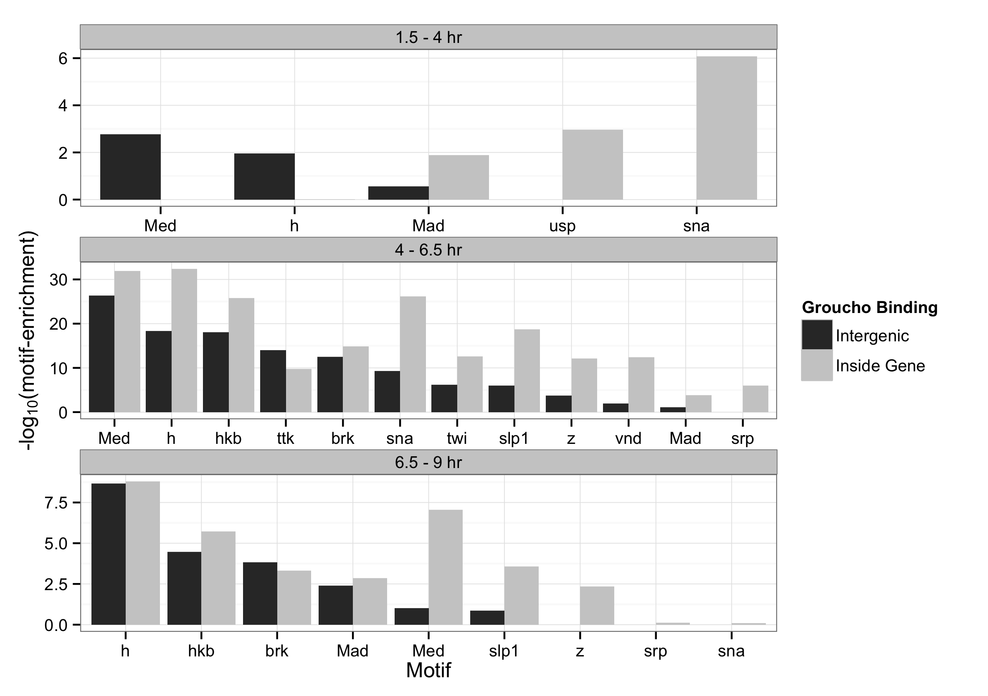
Binding sites are enriched for motifs of Gro-interacting factors

Slide 19
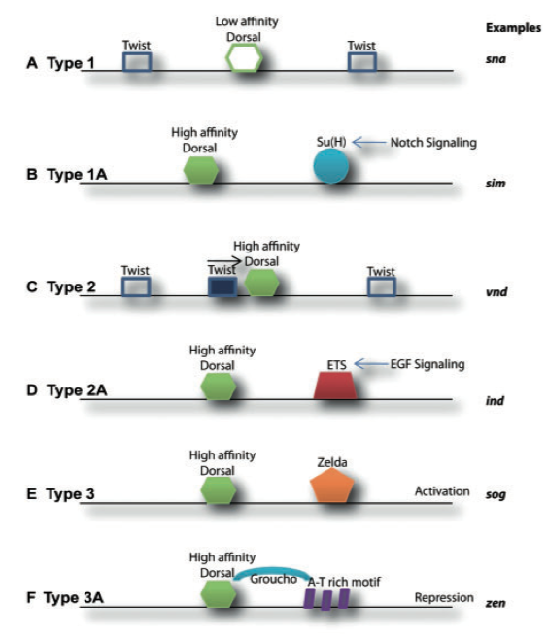
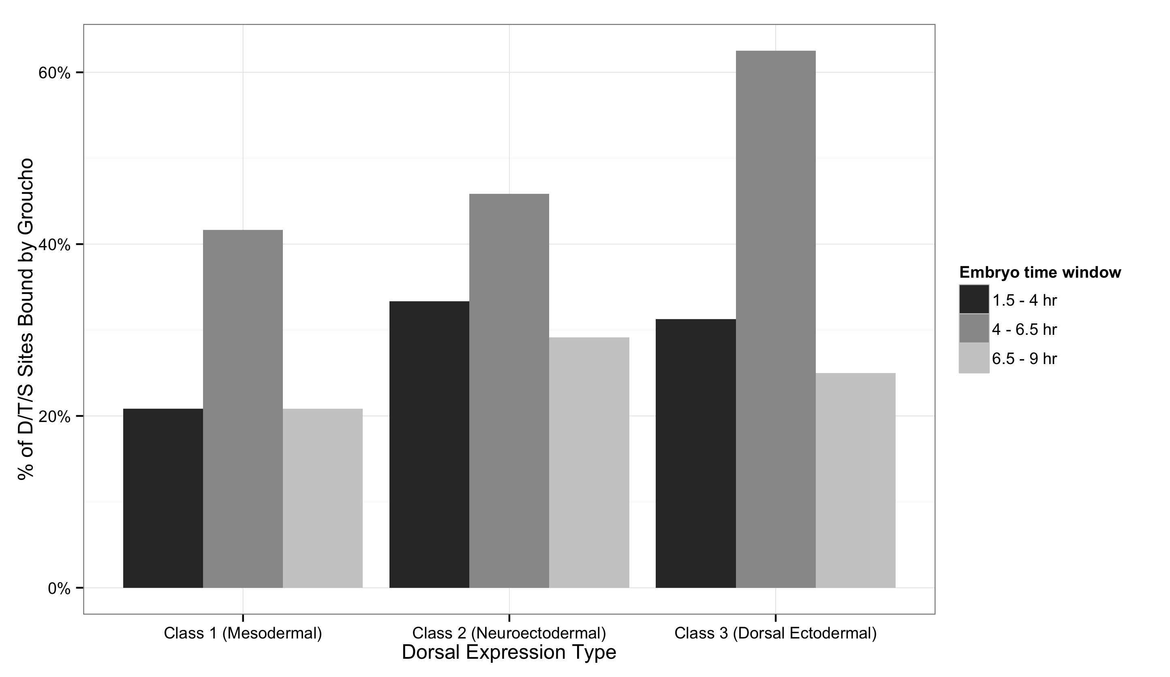
Gro is found at all classes of Dorsal binding site
Chopra and Levine, 2009
Notes:
Start with known and snail
I propose that ...

Slide 20
Outline
A genome-wide survey of Groucho in the early embryo
Identifying components of the Groucho gene regulatory network
Groucho regulation and RNA PolII stalling

Slide 21
Integrating Gro binding and transcriptome data in embryos
All expressed genes
All expressed genes
Responsive in gro gain- and loss-of-function embryos
Calculate “Gro occupancy score”
Internal or adjacent Gro binding
Define occupancy score cutoff from response curve
Gro dosage responsive target genes
Gro occupancy score
target genes

Slide 22
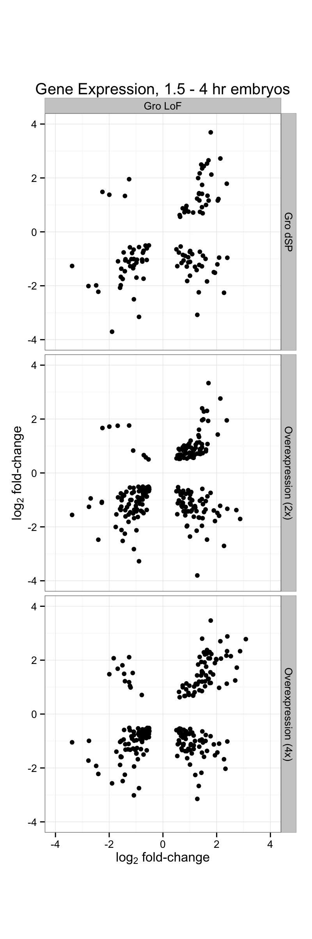
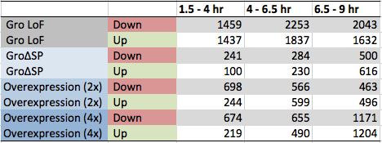
Perturbation of Groucho levels affects thousands of genes

Slide 23
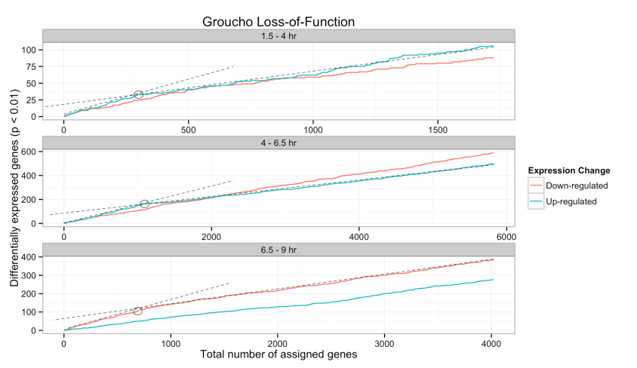
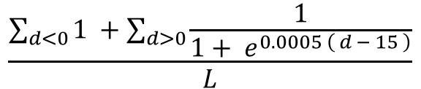
$$\frac{\sum_{d<0}{1 }+\sum_{d>0}{\frac{1}{1+ e^{0.0005 \left( d − 15 \right)}}}}{L}$$
Gro-occupancy-score =

Slide 24
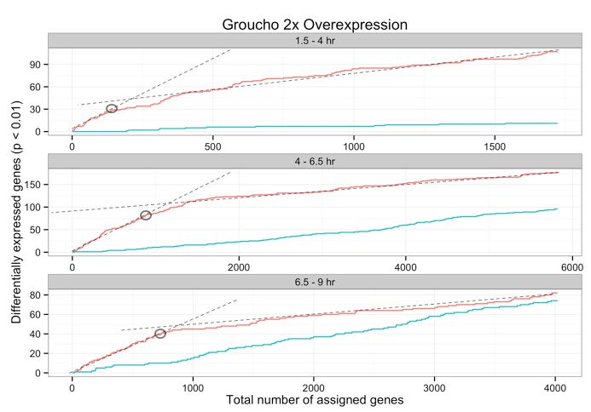
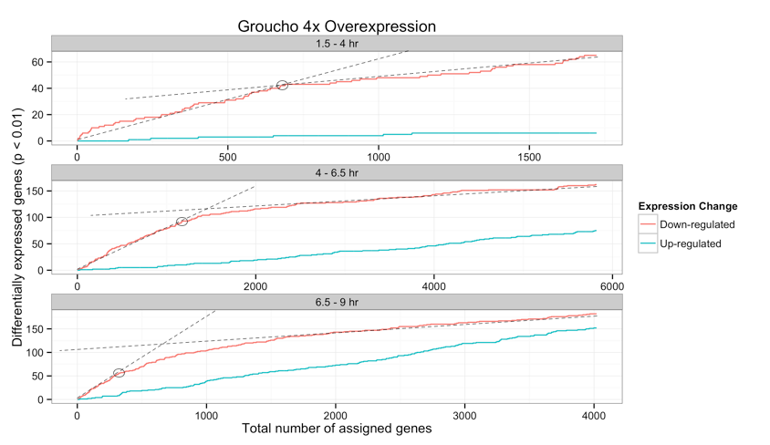
Notes:
Start with Gro gain of function
x-axis: Gro occupancy rank

Slide 25
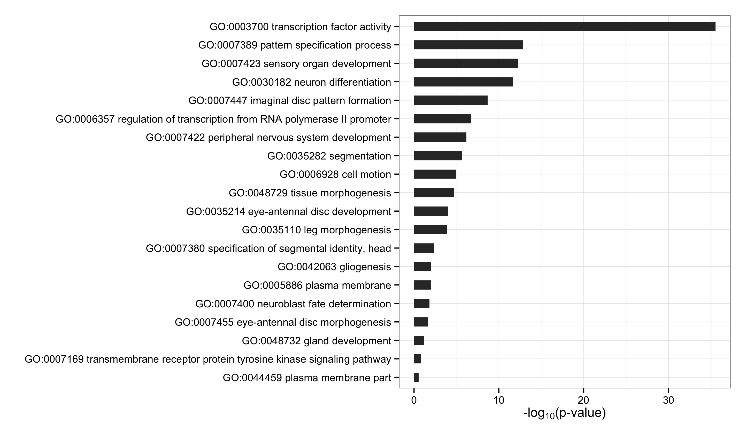
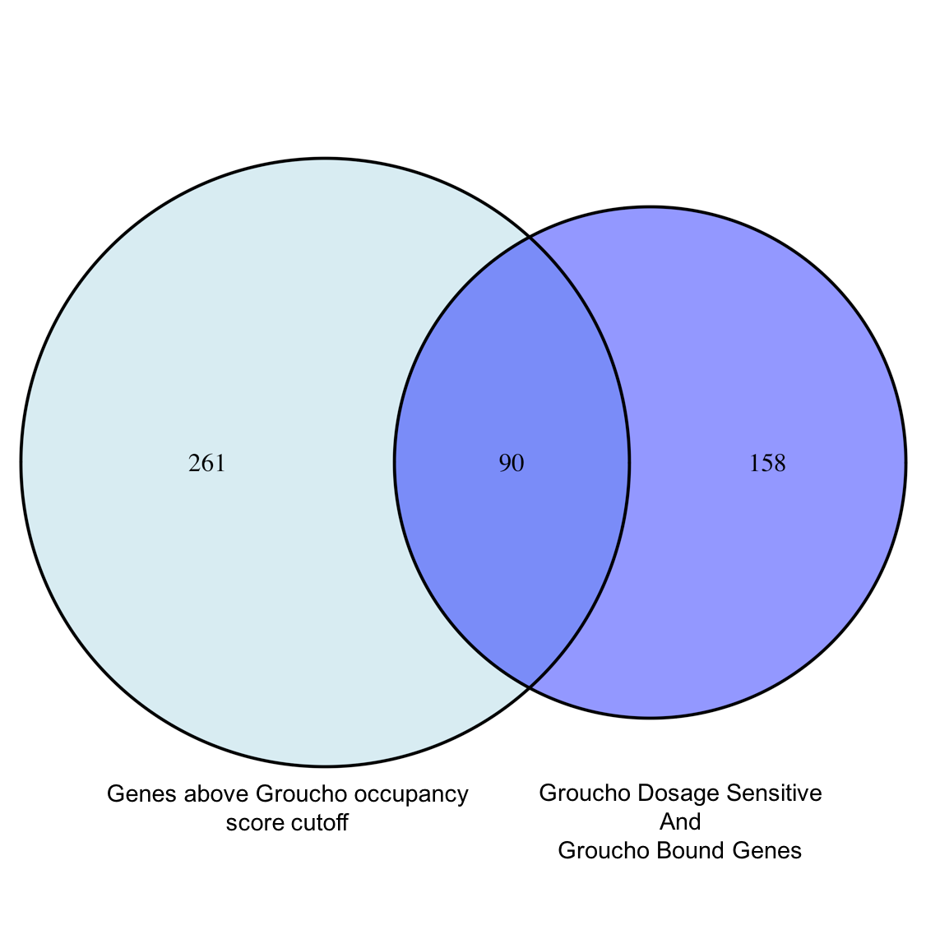
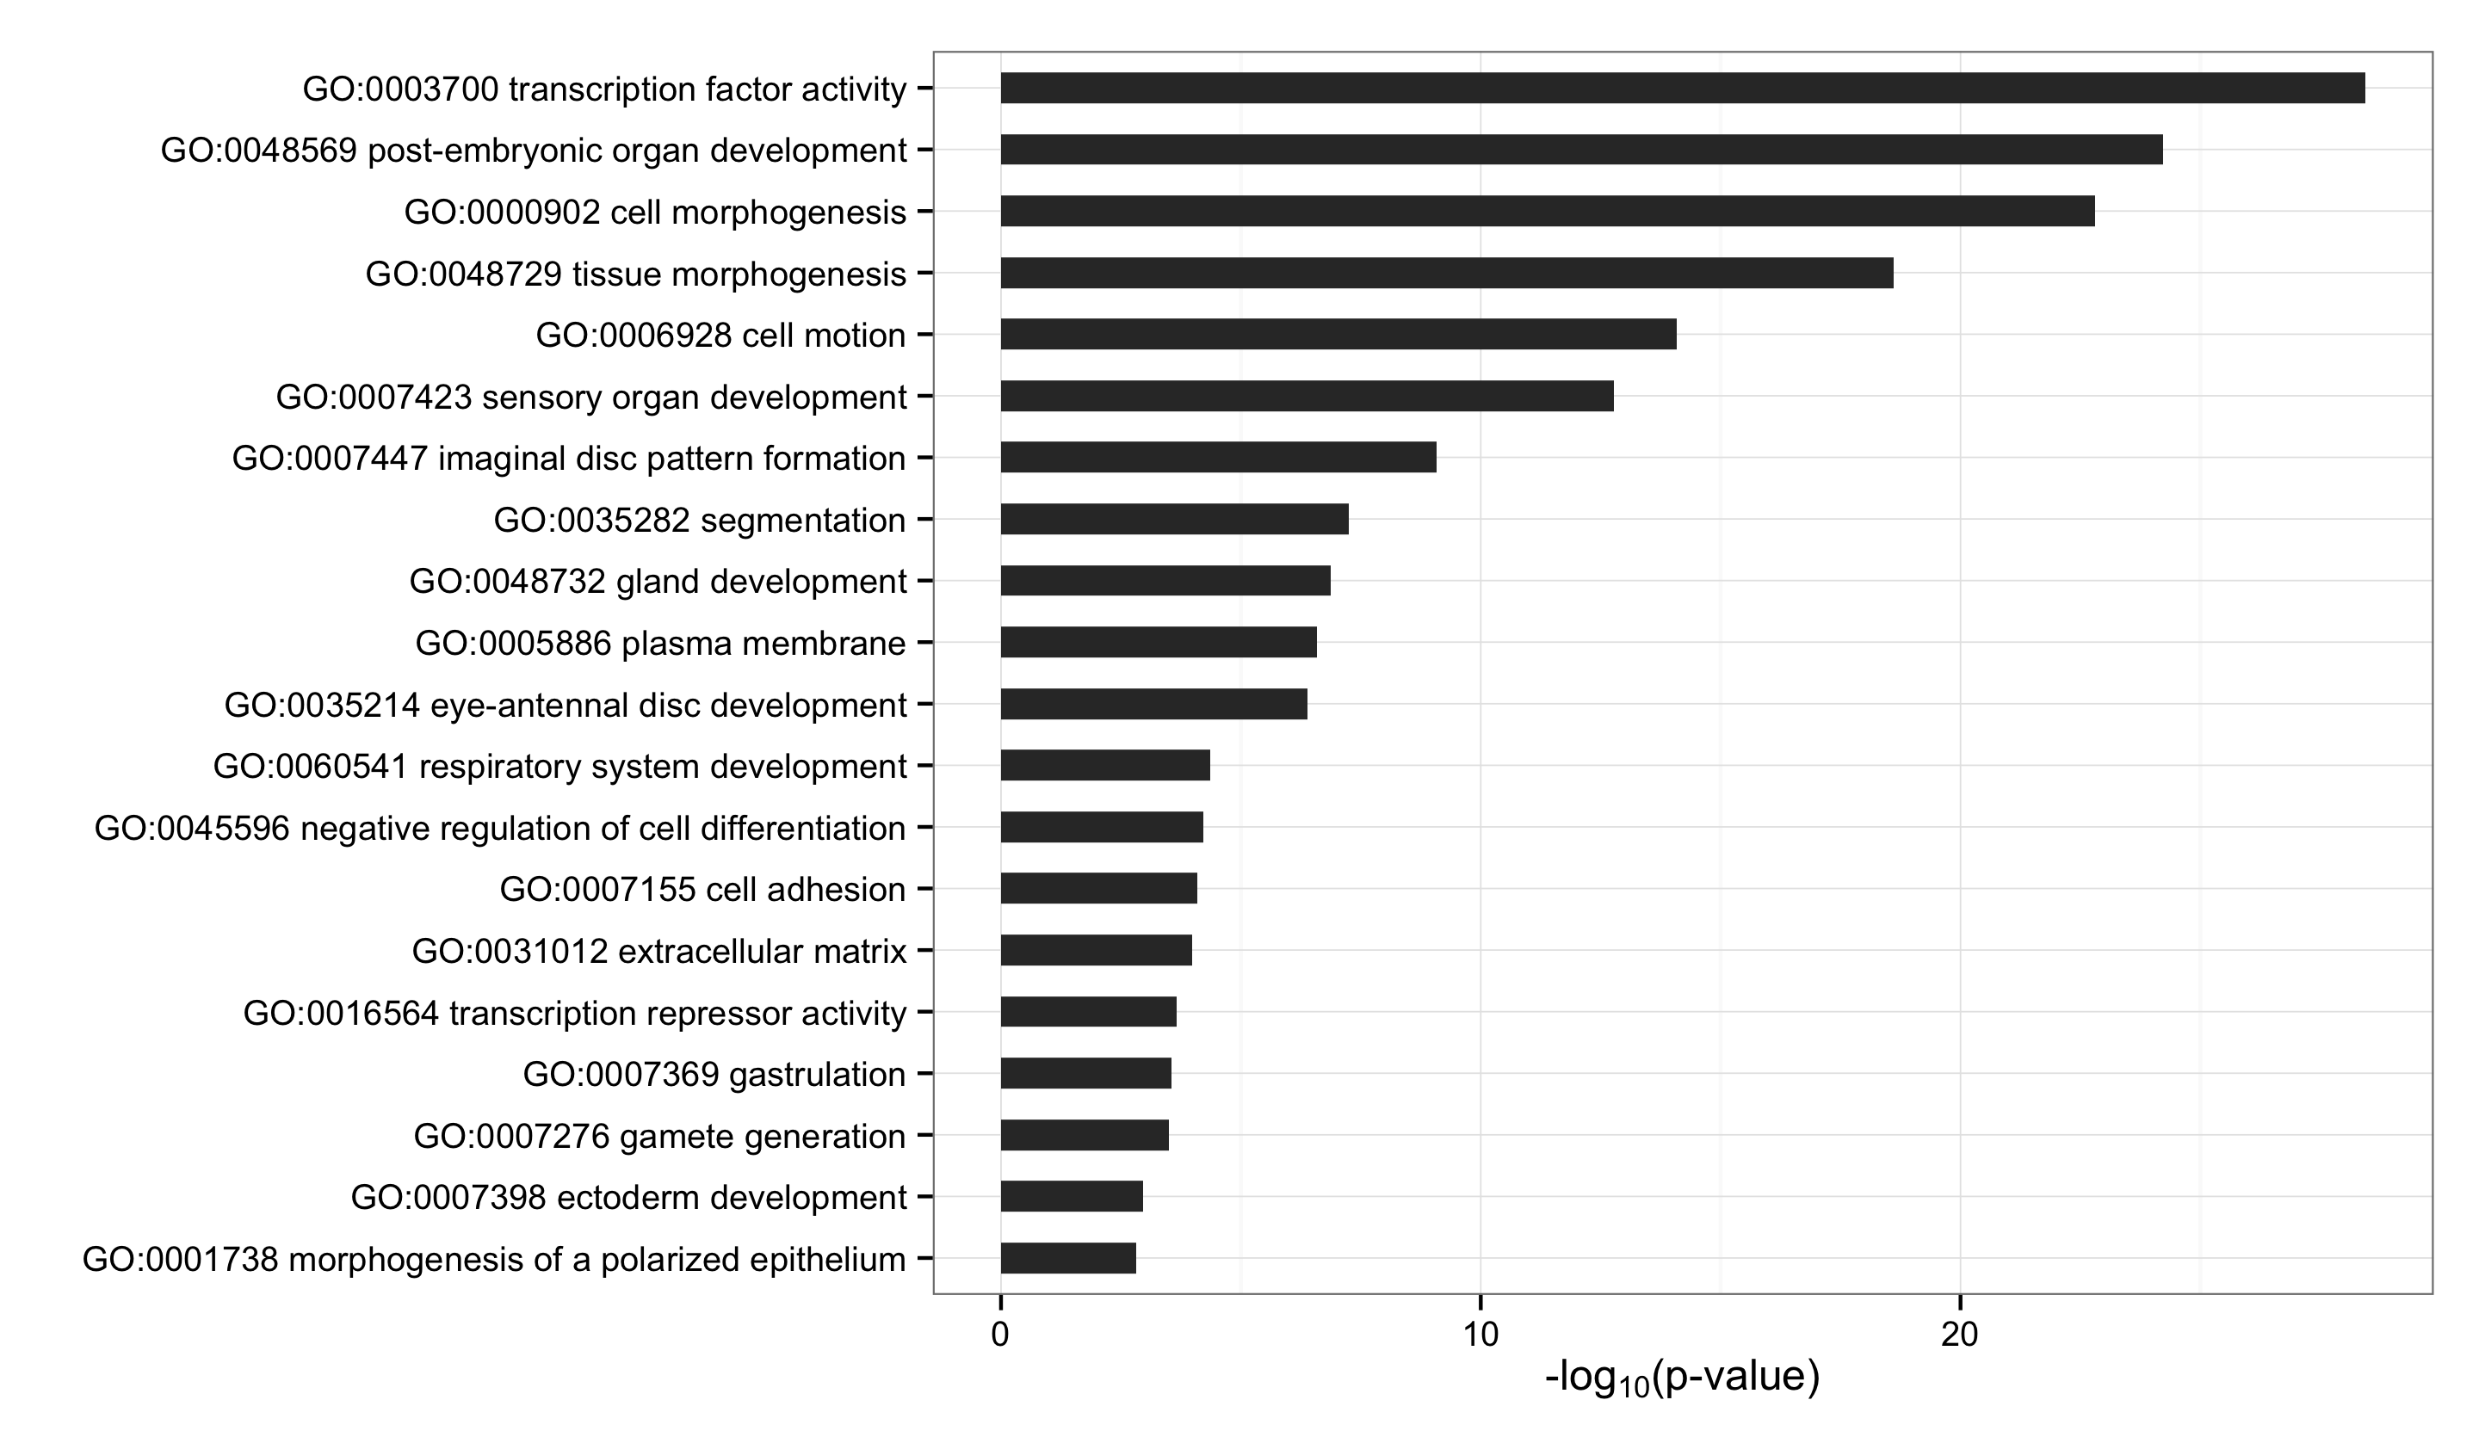
Gro Targets by Dosage Response
Gro Targets by Occupancy Score
Notes:
Focus on gro occupancy

Slide 26
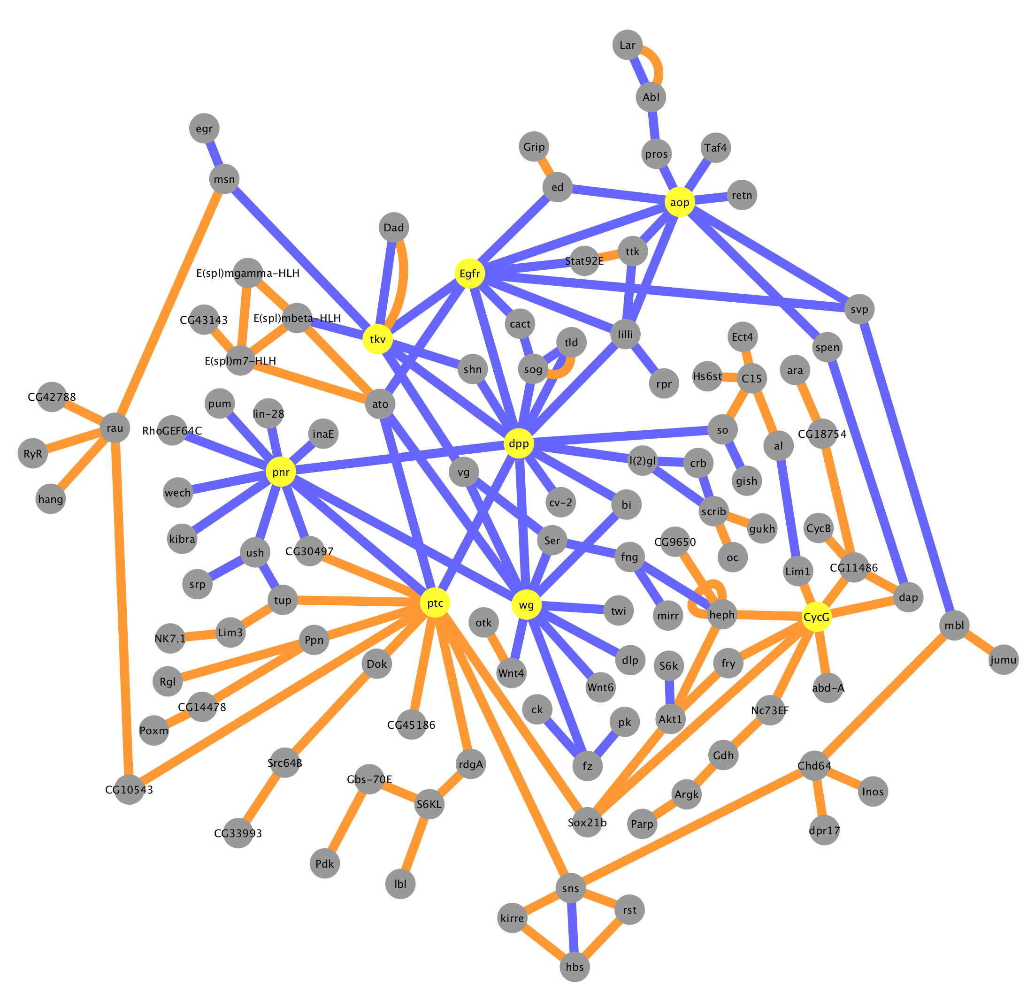
Gro Targets by Occupancy Score
Physical interaction
Genetic interaction

Slide 27
Outline
A genome-wide survey of Groucho in the early embryo
Identifying components of the Groucho gene regulatory network
Groucho regulation and RNA PolII stalling

Slide 28
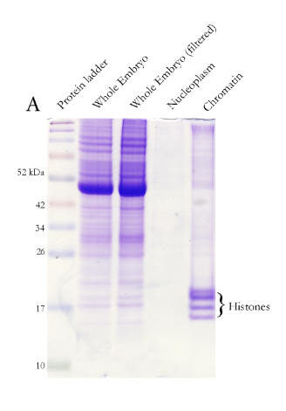
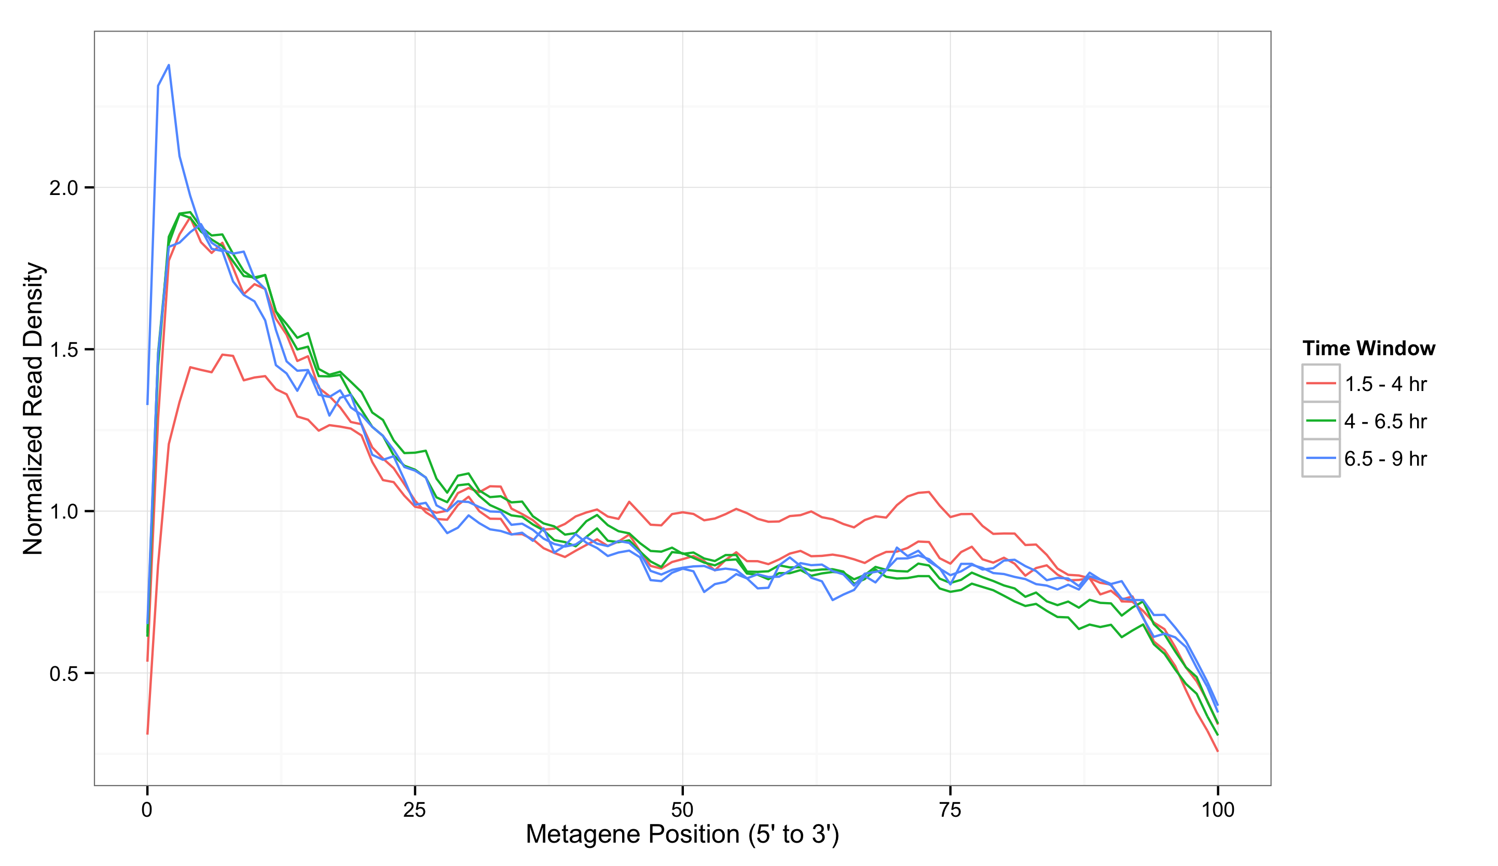
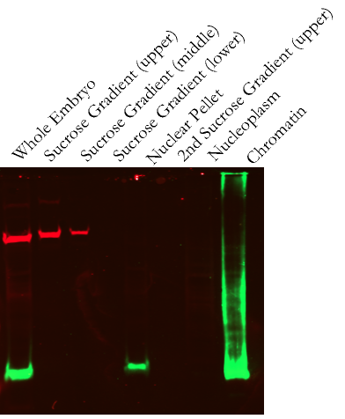
Isolation of nascent pre-mRNA
α-tubulin
α-H3
Notes:
Set-up PolII stalling

Slide 29
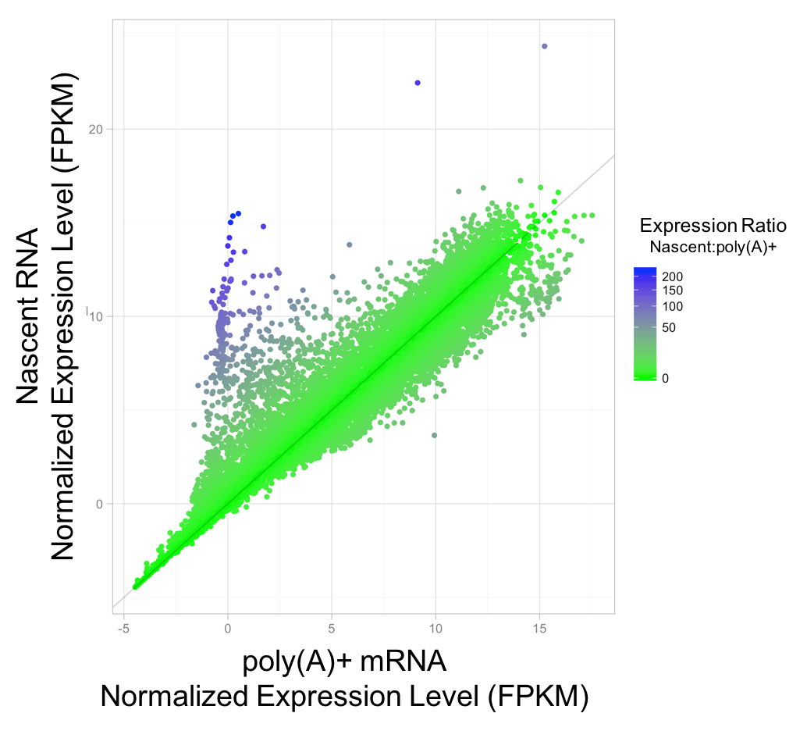
Different relative transcript abundance in nascent versus total RNA

Slide 30
Nascent-RNA is depleted for maternally contributed transcripts
Notes:
Remove non-polyA points from plot
LImit to maternal

Slide 31
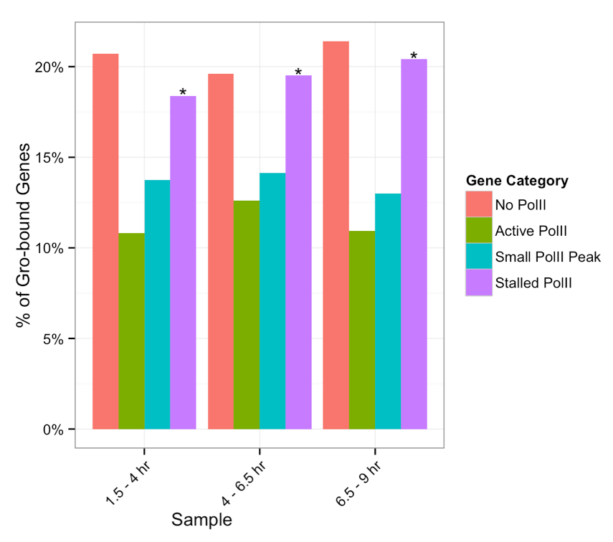
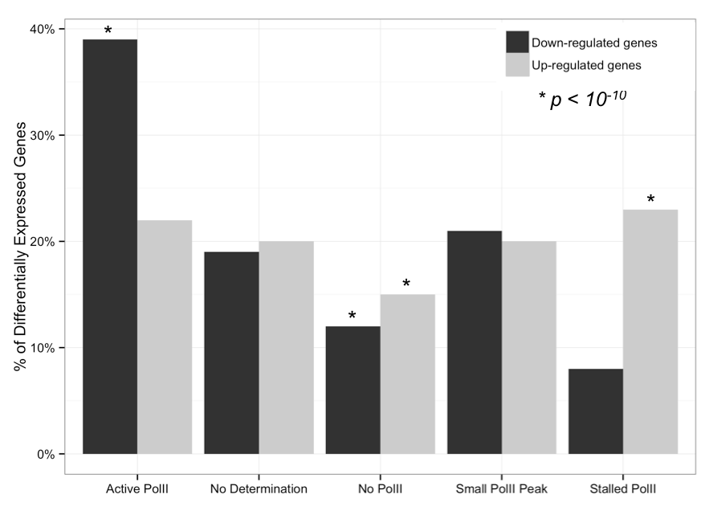
Gro bound and repressed genes are enriched for stalled PolII

Slide 32
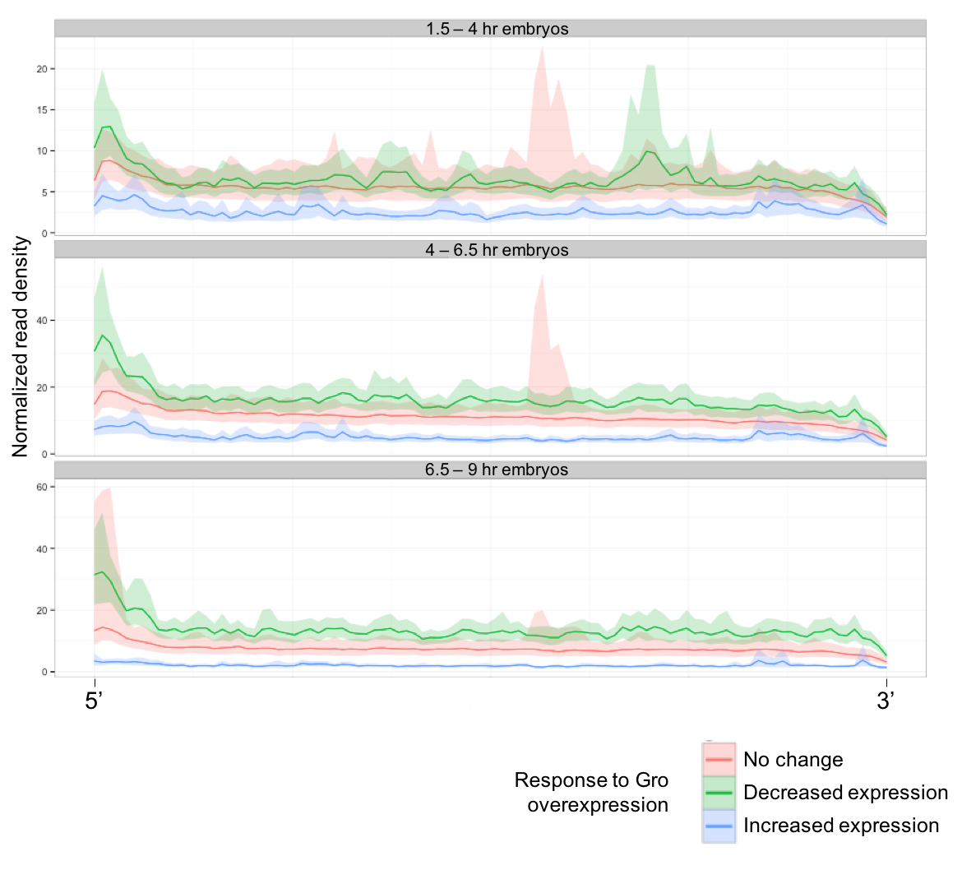
Gro-repressed genes are enriched for 5’ read density
Notes:
Remove shading

Slide 33
Conclusion
Gro binding is inconsistent with a spreading model of long-range repression
Gro may be recruited or loop directly into promoter-proximal regions to establish repression
Gro regulates the inputs and outputs of multiple signaling pathways
Gro-repressed genes are enriched for poised PolII
May represent priming for rapid/synchronous activation

Slide 34
Acknowledgements
Courey Lab
Albert Courey
Joseph Cao
Kenny Chen
Mitchell Kim
Pak Kwong
Wiam Turki-Judeh
Tom Yau
Committee
Dr. James Bowie
Dr. Michael Carey
Dr. Catherine Clarke
Dr. Volker Hartenstein
Collaborators
Sean Gallaher (Merchant Lab)
Kelvin Zhang (Zipursky Lab)

